Slide 1
Night/Weekend Team
Presentation
- Peter Franzese

Slide 2
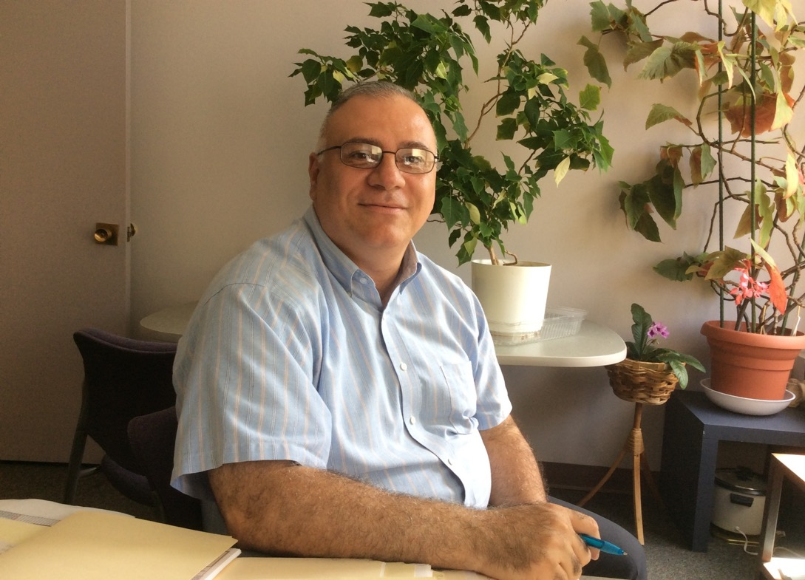
Night/Weekend Staff:
Peter Franzese-Manager Victor Santiago-Supervisor

Slide 3
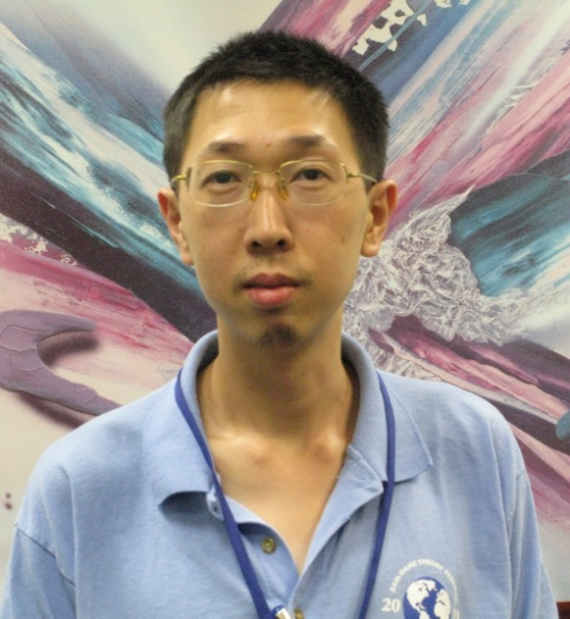
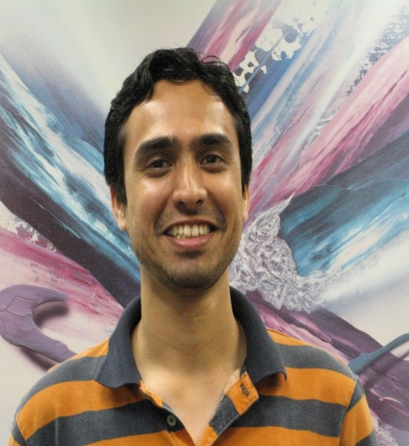
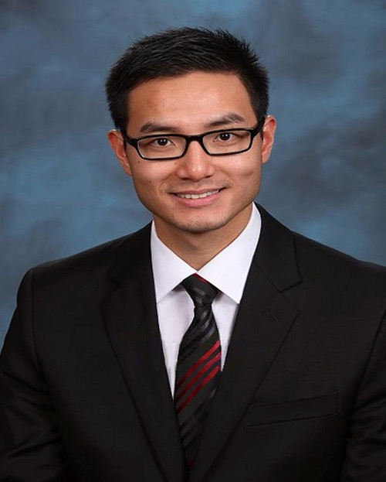
Graduate Liaisons
Frank Cheng Deodutt Kotasthane Hao Wang

Slide 4
Role and Responsibilities:
Provide night/weekend coverage to Main Stacks, NRR and CRR.
Assist with West Campus branch libraries and provide remote support to HSL.
Create Patron Records
Respond to patrons questions at Reference Desk and from LibChat.
Supervise and assign work to student staff.
Assist with Book Sale.
Address Melville Library building issues and concerns.
Work with Police in emergency situations.
Contact facilities when necessary.
Provide coverage during finals week extended hours in NRR and CRR until 4am.

Slide 5
Statistics from Finals Extended Hours-CRR-Spring 2015

Slide 6
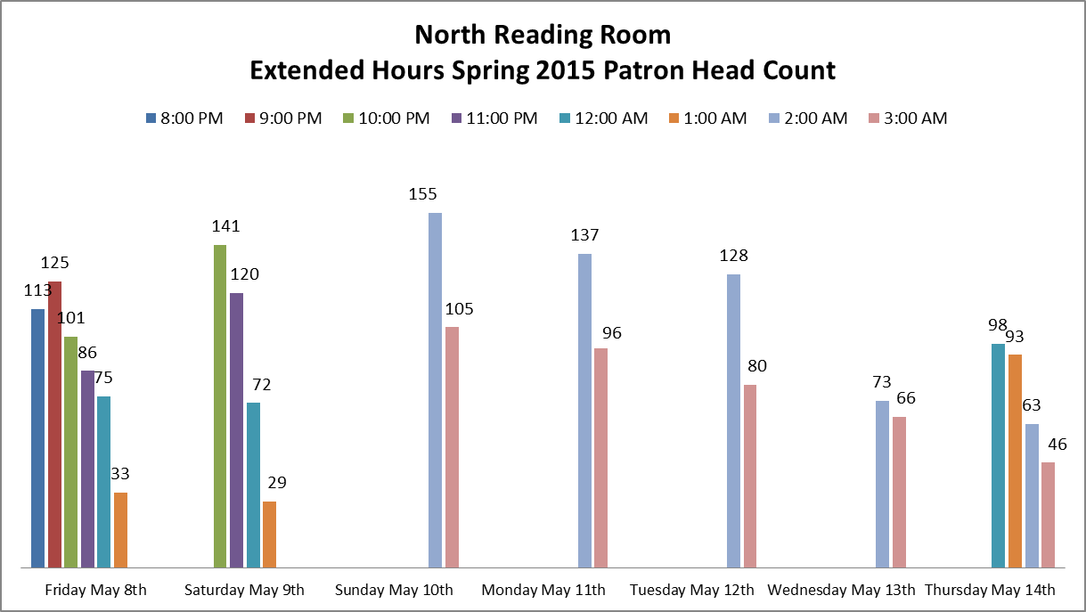
Statistics from Finals Extended Hours-NRR-Spring 2015

Slide 7
Questions if any….
Thank You!!!

