Slide 1
Library Operations and Facilities

Slide 3
Mail for the entire building : receiving

Slide 4
Mail Delivering

Slide 5
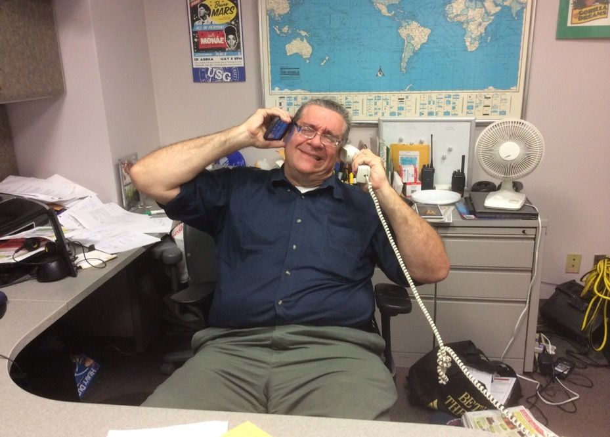
Maintenance and Janitorial Service
Receive and follow up repair and cleaning requests from the entire building

Slide 6
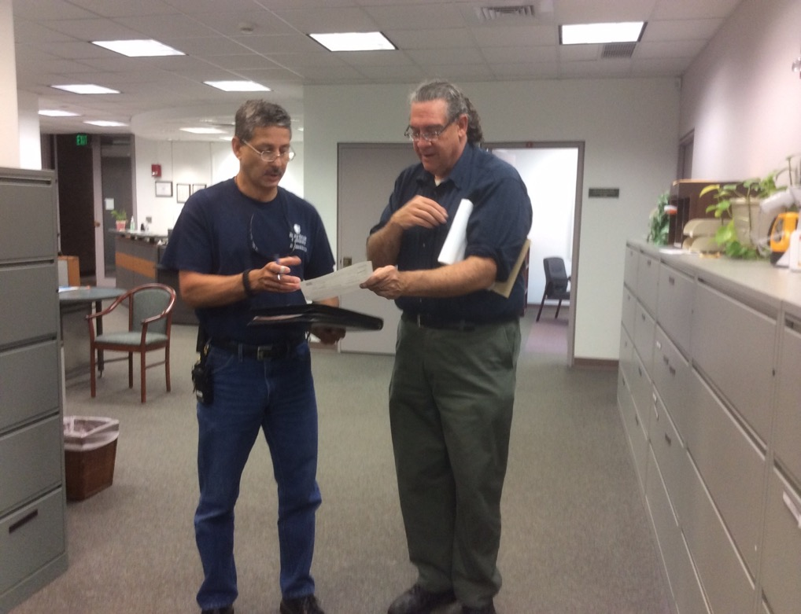
Interior Rehab Project
Coordinate with TelNet, Clint Support, CPDC and requestors

Slide 7
Procedures follow up
- Collect budge information
- Submit request for approval
- Work out contract with Lib. Administration
- Final inspection support and followup

Slide 8
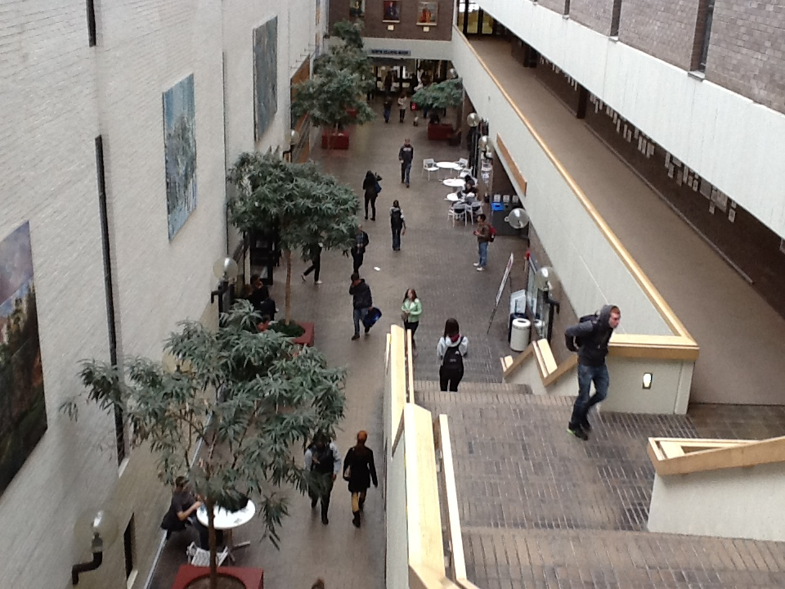
Galleria Events Coordination Reservation and Space Scheduling
(picture)

Slide 9
Key Control

Slide 10
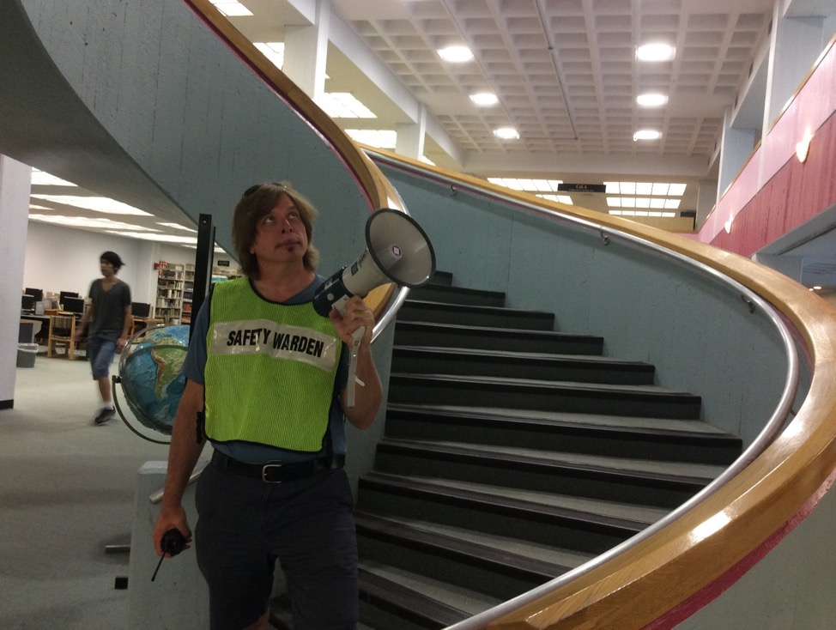
Security
Warden team:
recruiting,
training

Slide 11
Campus Fire Department

Slide 12
Emergency equipment installation and maintenance

Slide 13
Severe Weather issues

Slide 14
University Police Department Liaison

Slide 15
And many more….. Questions ?

